Slide 1

Inheritance Part 2 Java - The Complete Reference Herbert Schildt Chapter 8

Slide 2
Outline
Using super
Using super to Call Superclass Constructors
A second use of super
Multilevel Inheritance Hierarchy
When Constructors Are Executed
Method Overloading

Slide 3
Using super

Slide 4
Using super to Call Superclass Constructors
Whenever a subclass needs to refer to its immediate superclass, it can do so by use of the keyword super.
A subclass can call a constructor defined by its superclass by use of the following form of super:
super(arg-list);
Here, arg-list specifies any arguments needed by the constructor in the superclass.
super() must always be the first statement executed inside a subclass’s constructor.

Slide 5
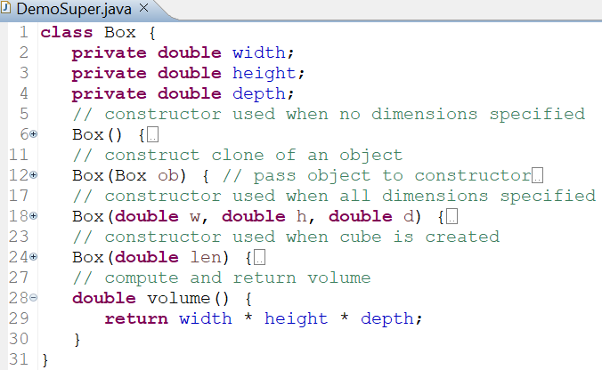
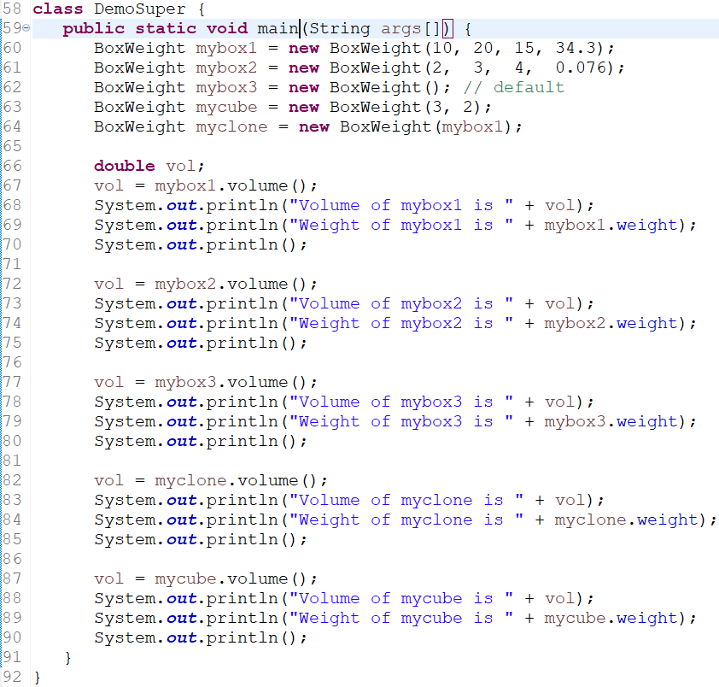
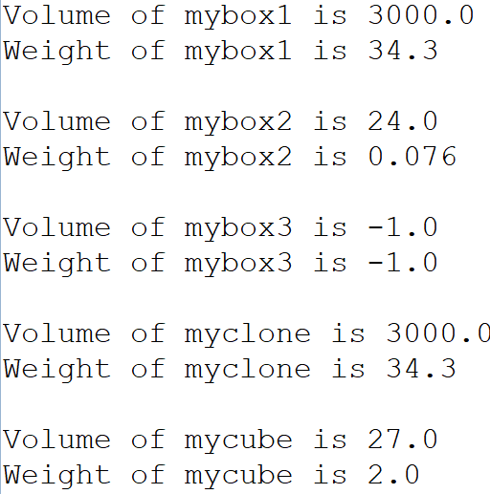
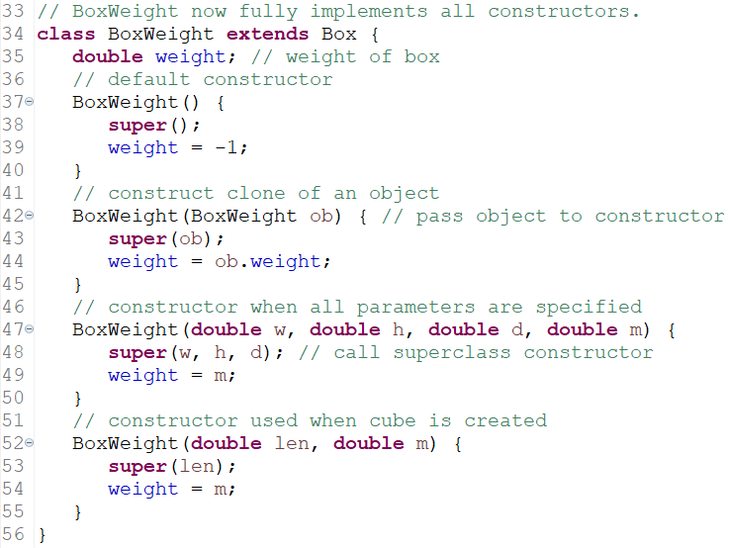
Example: super to Call Superclass Constructors
OUTPUT

Slide 6
Using super to Call Superclass Constructors
In the DemoSuper example, weight, height, and depth are private to Box class, so they cannot be accessed directly in BoxWeight class’s constructors. This ensures encapsulation.
Since constructors can be overloaded, super() can be called using any form defined by the superclass.
The constructor executed will be the one that matches the arguments.

Slide 7
Using super to Call Superclass Constructors
Notice that super() is passed an object of type BoxWeight (line 43) — not of type Box.
This still invokes the constructor Box(Box ob).
As mentioned earlier, a superclass variable (i.e., reference) can be used to reference any object derived from that class (i.e., subclass objects).
Thus, we are able to pass a BoxWeight object to the Box constructor.
Of course, Box only has knowledge of its own members.

Slide 8
Review of the key concepts of super()
When a subclass calls super(), it is calling the constructor of its immediate superclass.
Thus, super() always refers to the superclass immediately above the calling class.
This is true even in a multileveled hierarchy of inheritance.
Also, super() must always be the first statement executed inside a subclass constructor.

Slide 9
A Second Use of super
Within a subclass method (including constructors), the keyword super can be used to refer to the superclass of the subclass in which it is used.
General form:
super.member
Here, member can be either a method or an instance variable.
This second form of super is most applicable to situations in which member names of a subclass hide members by the same name in the superclass.

Slide 10
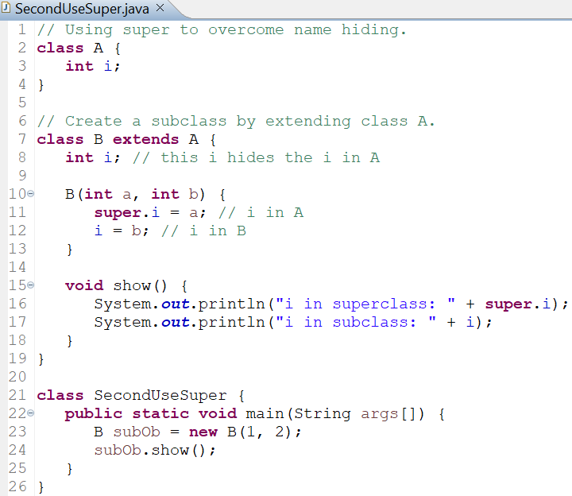

Example: Second Use of super
OUTPUT

Slide 11
Multilevel Inheritance Hierarchy

Slide 12
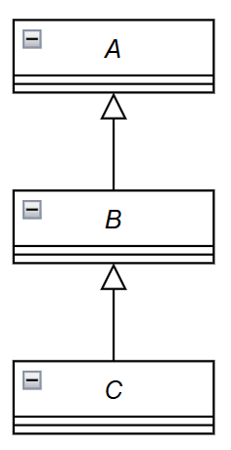
Multilevel Inheritance Hierarchy
We can build hierarchies that contain as many layers of inheritance as needed.
It is perfectly acceptable to use a subclass as a superclass of another.
For example, given three classes called A, B, and C, C can be a subclass of B, which is a subclass of A.
When this type of situation occurs, each subclass inherits all of the traits
found in all of its superclasses.
In this case, C inherits all aspects (i.e., member variables and methods) of B and A.

Slide 13
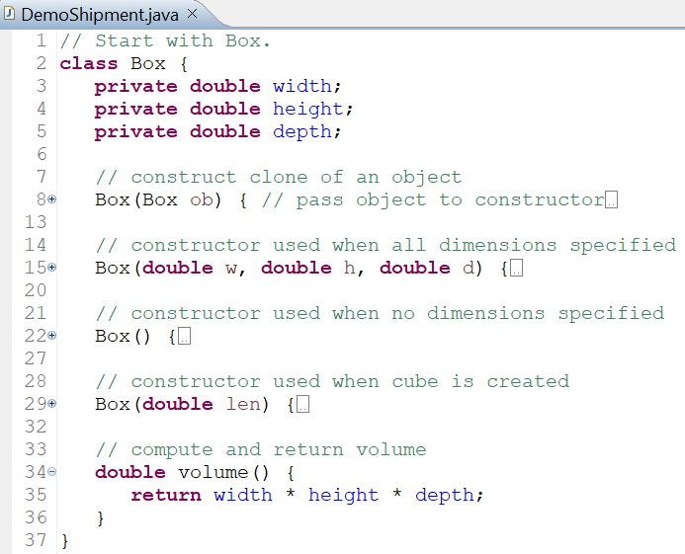
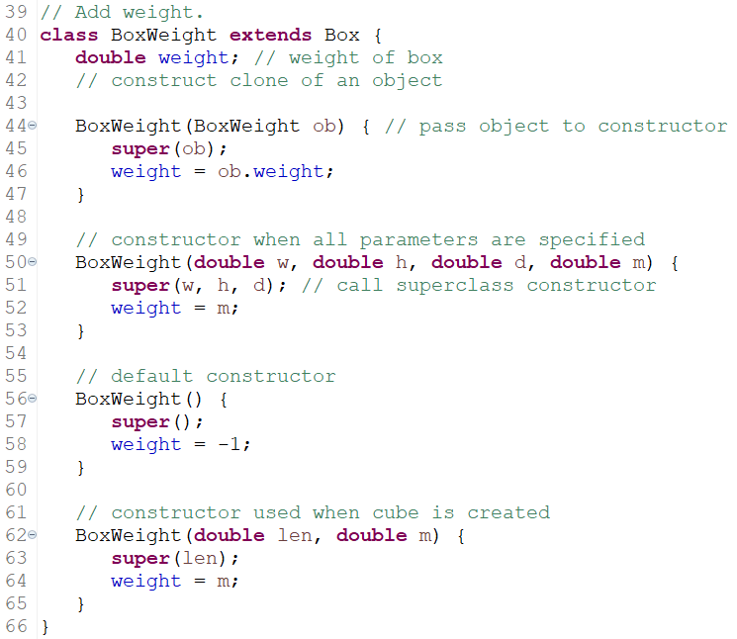
Example: Three Levels of Inheritance Hierarchy

Slide 14
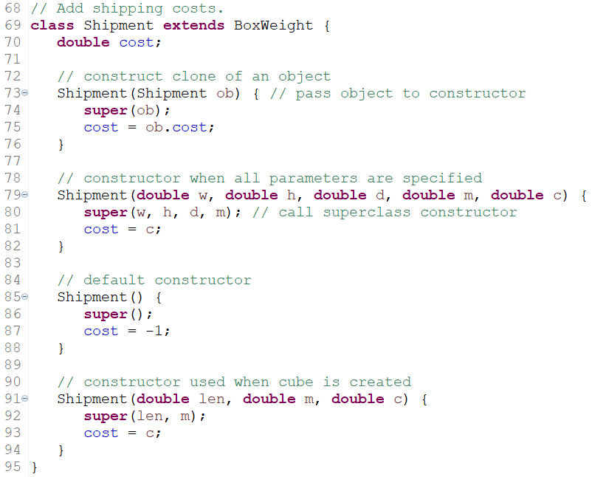
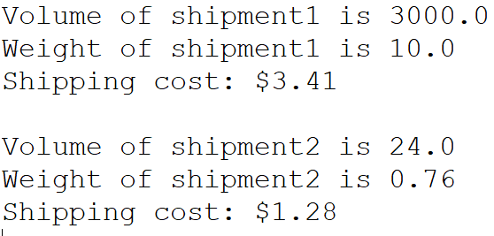
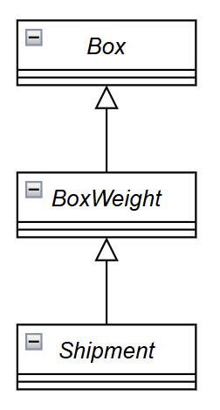
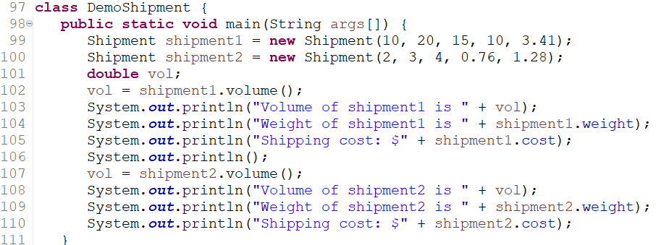
Example: Three Levels of Inheritance Hierarchy
OUTPUT

Slide 15
Example: Three Levels of Inheritance Hierarchy
In the DemoShipment example, the subclass BoxWeight is used as a superclass to create the subclass called Shipment.
Shipment inherits all of the traits (member variables and methods) of BoxWeight and Box, and adds a field called cost, which holds the cost of shipping such a parcel.
This is part of the significance of inheritance - it allows the reuse of code.

Slide 16
Example: Three Levels of Inheritance Hierarchy
Another Important Point on super() from the Previous Example:
It always refers to the constructor in the closest superclass.
The super() in Shipment calls the constructor in BoxWeight.
The super() in BoxWeight calls the constructor in Box.
In a class hierarchy, if a superclass constructor requires parameters, then all subclasses must pass those parameters "up the line of the hierarchy".
This is true whether or not a subclass needs parameters of its own.

Slide 17
Example: Three Levels of Inheritance Hierarchy
A Practical Note:
In the preceding program, the entire class hierarchy, including Box, BoxWeight, and Shipment, is shown all in one file (DemoShipment.java).
This is done only for beginners' convenience.
In Java, all three classes could have been placed into their own files and compiled separately.
In fact, using separate files is the norm, not the exception, in creating class hierarchies.

Slide 18
When Constructors Are Executed

Slide 19
When Constructors Are Executed
In a class hierarchy, constructors complete their execution in order of derivation, from superclass to subclass.
Further, since super() must be the first statement executed in a subclass’s constructor, this order is the same whether or not super() is used.
If super( ) is not used, then the default or parameterless constructor of each superclass will be executed.

Slide 20
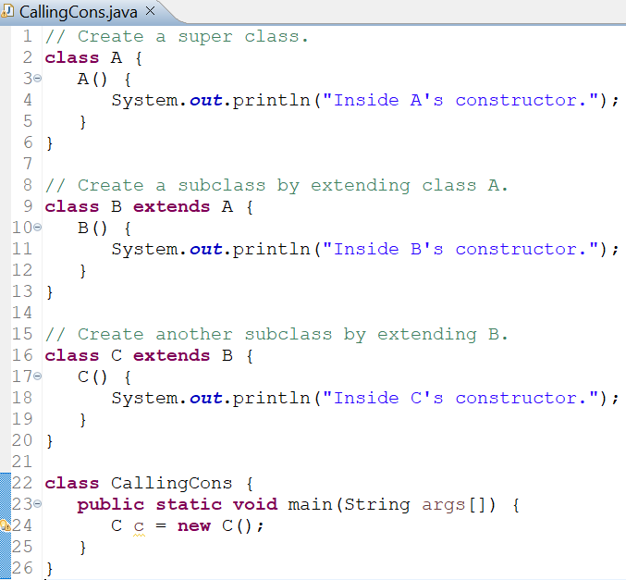
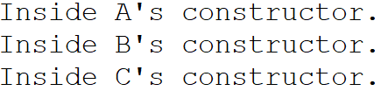
Example: Constructors Call Sequence
OUTPUT

Slide 21
When Constructors Are Executed
Significance
It makes sense that constructors complete their execution in order of derivation.
Because a superclass has no knowledge of any subclass, any initialization it needs to perform is separate from and possibly prerequisite to any initialization performed by the subclass.
Therefore, it must complete its execution first.

Slide 22
Method Overriding

Slide 23
Method Overriding
In a class hierarchy, when a method in a subclass has the same name and type signature as a method in its superclass, then the method in the subclass is said to override the method in the superclass.
When an overridden method is called from within its subclass, it will always refer to the version of that method defined by the subclass.
The version of the method defined by the superclass will be hidden.

Slide 24
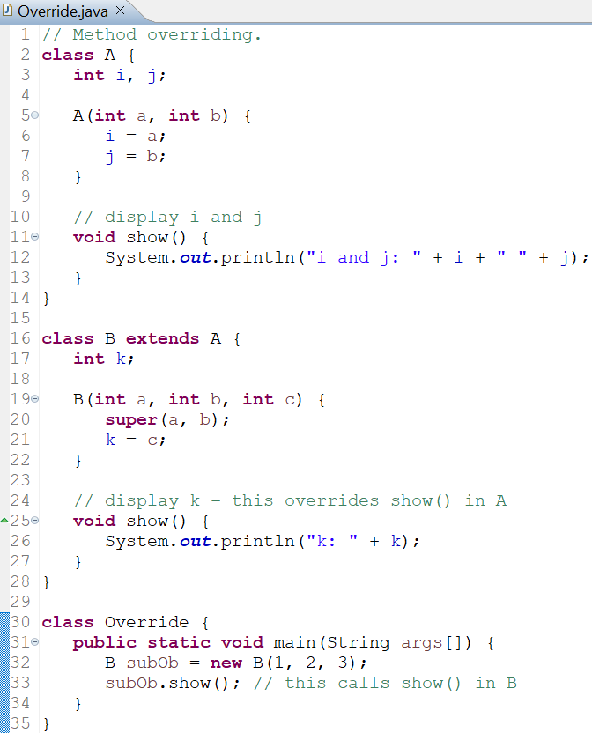

Example: Method Overriding
OUTPUT

Slide 25
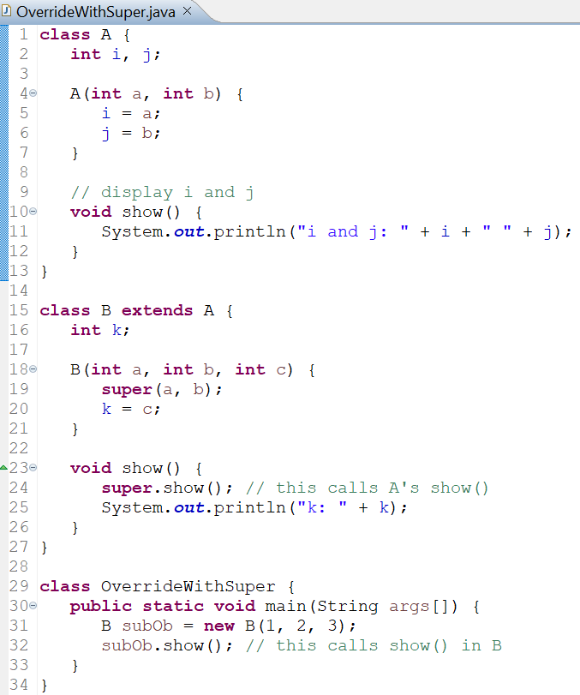

Accessing the Superclass Version of an Overridden Method
If we need to access the superclass version of an overridden method, we can do so by using the super keyword.
Here, super.show() calls the superclass version of show().
OUTPUT

Slide 26
Method Overriding vs Overloading
Method overriding occurs only when the names and the type signatures of the two methods are identical.
If they are not, then the two methods are simply overloaded.

Slide 27
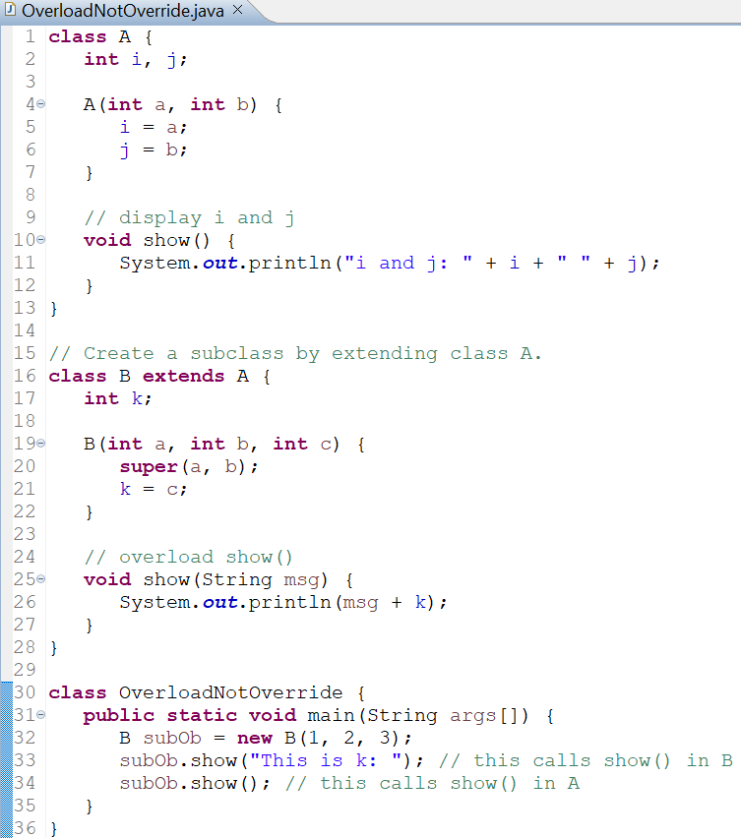

Example: Method Overriding vs Overloading
OUTPUT

